Slide 1
Graduate Council Meeting
Nov. 5th, 2025

Slide 2
Graduate Council Meeting - Slide 2
Call to Order

Slide 3
Agenda
Roll Call

Slide 4
Agenda
Roll Call
Approval of minutes from Oct. 1st, 2025 meeting

Slide 5
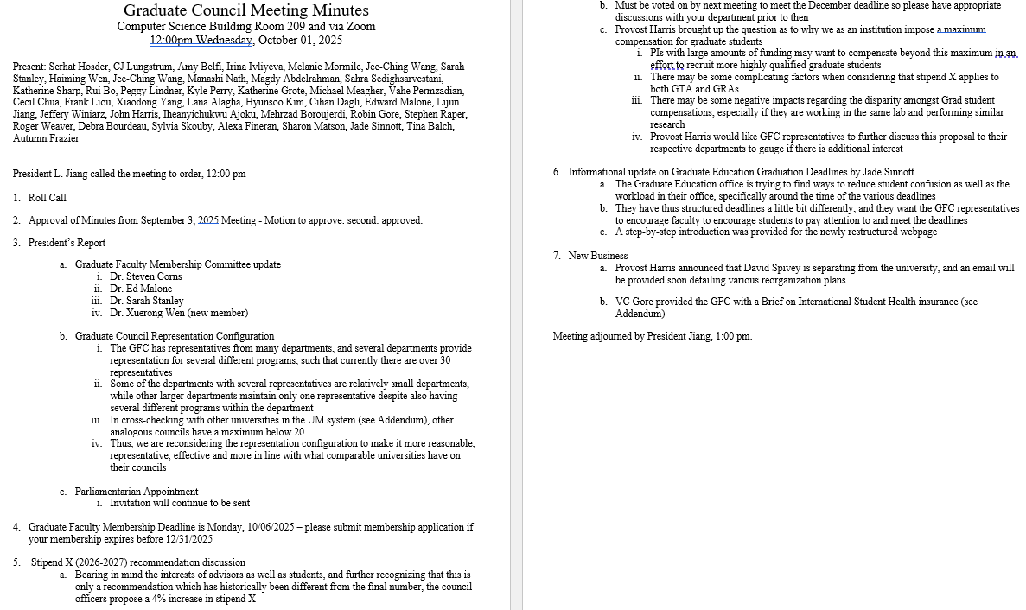

Slide 6
Agenda
Roll Call
Approval of minutes from Oct. 1st, 2025 meeting
President’s report
  Parliamentarian Appointment

Slide 7
Agenda
Roll Call
Approval of minutes from Oct. 1st, 2025 meeting
President’s report
The next Graduate Faculty Meeting
  Monday, December 1, 2025, at 4:00pm
  Carver/Turner Room at the Havener Center
  The agenda may include
    Approval of the Fall Commencement List
    Graduate Faculty Membership Vote
    Motions Approved by Graduate Council

Slide 8
Agenda
Roll Call
Approval of minutes from Oct. 1st, 2025 meeting
President’s report
The next Graduate Faculty Meeting
  Monday, December 1, 2025, at 4:00pm
  Carver/Turner Room at the Havener Center
  The agenda may include
    Approval of the Fall Commencement List
    Graduate Faculty Membership Vote
    Motions Approved by Graduate Council
The attendance of all faculty members would be greatly appreciated

Slide 9
Agenda
Roll Call
Approval of minutes from Oct. 1st, 2025 meeting
President’s report
The next Graduate Faculty Meeting
Provost John Harris to discuss dual PhD programs

Slide 10
Agenda
Roll Call
Approval of minutes from Oct. 1st, 2025 meeting
President’s report
The next Graduate Faculty Meeting
Provost John Harris to discuss dual PhD programs
Stipend X Recommendation Vote - Recommend to increase Stipend X by 4% for the 2026–2027 academic year

Slide 11
Agenda
Roll Call
Approval of minutes from Oct. 1st, 2025 meeting
President’s report
The next Graduate Faculty Meeting
Provost John Harris to discuss dual PhD programs
Stipend X Recommendation Vote - Recommend to increase Stipend X by 4% for the 2026–2027 academic year
Discussion to adjust the required number of 6000-level lecture credit hours from nine to six for a non-thesis MS and to adjust the required number of 6000-level lecture credit hours for PhD students from zero to a minimum of nine

Slide 12
Agenda
Discussion to adjust the required number of 6000-level lecture credit hours from nine to six for a non-thesis MS and to adjust the required number of 6000-level lecture credit hours for PhD students from zero to a minimum of nine
The 6000-level courses, often referred to as Ph.D.-level courses, if taught at the designated level, serve as advanced knowledge-building components of the graduate curriculum. They are designed primarily for doctoral students, and, to some extent, master’s students with appropriate preparation. These courses equip students with a set of advanced tools to support research and critical thinking skills, especially for PhD students
Missouri S&T, per the graduate catalog, requires 9 credit hours of 6000 level courses in the MS curriculum , and no 6000 level courses are required in the PhD curriculum. I do not see the rational in requiring 6000 level courses for MS students (regardless of the number), and none for those for which the courses are primarily designed for.
Motion:
(a) Reduce the number of 6000 level hours to 6 credit hours for MS:
(b) Change the required 6000 level hours for PhD students from 0 to a minimum of 9 hours credit hours

Slide 13
Agenda
Right now the nine-hour 6000-level requirement only applies to non-thesis students
  If this changes to six hours, would the thesis option also stay at six?
  Also, our master of engineering and second master’s programs currently require six hours of 6000-level coursework—would those remain the same or be adjusted as well?
Since Ph.D. students without a master’s need 30 total lecture hours and those with a master’s only need 12, would the nine-hour 6000-level requirement apply to both?
  That might create an imbalance for students who earned their master’s at S&T or be challenging if 6000-level course offerings are limited.

Slide 14
Agenda
Roll Call
Approval of minutes from Oct. 1st, 2025 meeting
President’s report
The next Graduate Faculty Meeting
Provost John Harris to discuss dual PhD programs
Stipend X Recommendation Vote - Recommend to increase Stipend X by 4% for the 2026–2027 academic year
Discussion to adjust the required number of 6000-level lecture credit hours from nine to six for a non-thesis MS and to adjust the required number of 6000-level lecture credit hours for PhD students from zero to a minimum of nine
Status report from Kathryn Northcut - Chair of the Personnel Committee

Slide 15
Agenda
Status report from Kathryn Northcut - Chair of the Personnel Committee
The Personnel Committee next meets on November 10 so there should be no new points between now and then:
Discussions about recent reorganizations, layoffs, riffing and goals of cost-saving, etc. Because this is personnel-related, no specific information is available. HR and RP&A members have heard our committee’s concerns that such actions result in damage to our aspirational goal of being a “destination of choice” for faculty and administrators
Taking action with respect to campus climate surveys, timing, scheduling
  Personnel committee members have received qualitative raw data (filtered/screened by IR) to review (this is new; was not done in the past)
  Personnel committee is going to try to get more action/results from the surveys then we’ve had in the past
  A deeper dive into the responses should help us identify areas that are actionable by senior admin or other leaders/groups, opening a conversation about how they are addressing these concerns & their goals/timelines
  Can’t do: control future committees’ decisions about when to do which surveys
  Acknowledge: there may be too many surveys (now or in the future, opinions will vary, but we aren’t seeing much effect. However, that’s not a reason to stop doing them, especially those with continuity of data to show trends.
We’re open to referrals, directly or through the link on the faculty senate committees web page, regarding topics people wish we would take up.

Slide 16
Agenda
Roll Call
Approval of minutes from Oct. 1st, 2025 meeting
President’s report
The next Graduate Faculty Meeting
Provost John Harris to discuss dual PhD programs
Stipend X Recommendation Vote - Recommend to increase Stipend X by 4% for the 2026–2027 academic year
Discussion to adjust the required number of 6000-level lecture credit hours from nine to six for a non-thesis MS and to adjust the required number of 6000-level lecture credit hours for PhD students from zero to a minimum of nine
Status report from Kathryn Northcut - Chair of the Personnel Committee
New Business

Slide 17
Agenda
ADJOURN

